Slide 1
MUMS a Measure of hUman Motion Similarity
Francisco J Torres Reyes

Slide 2
Outline of the Talk
Problem and Challenges
3D ChainCode
LABANotation
Contribution 1: Comparison Analysis of ChainCode and FastDTW
Contribution 2: Enhanced LABANotation for Rehabilitation
Contribution 3: System Architecture for HMTR
Lessons Learned
Future Direction
Conclusion

Slide 3
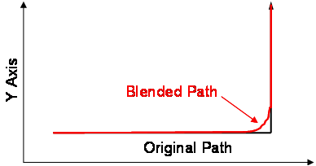
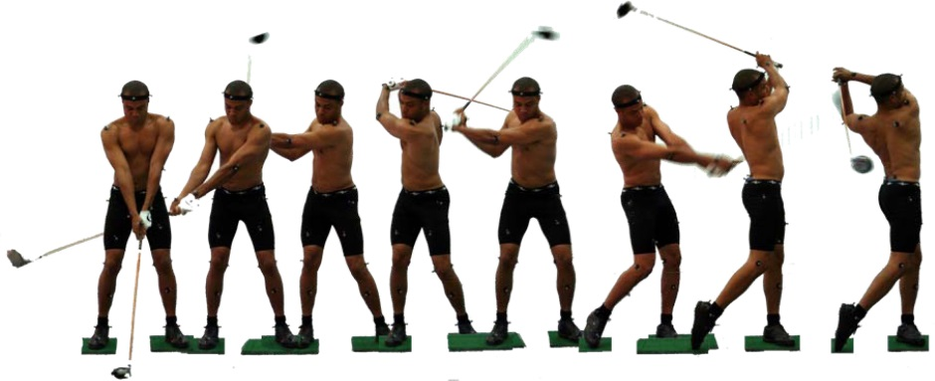
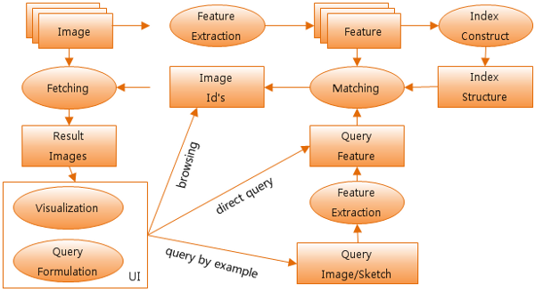
Why Measuring Human Motion Similarity?

Slide 4
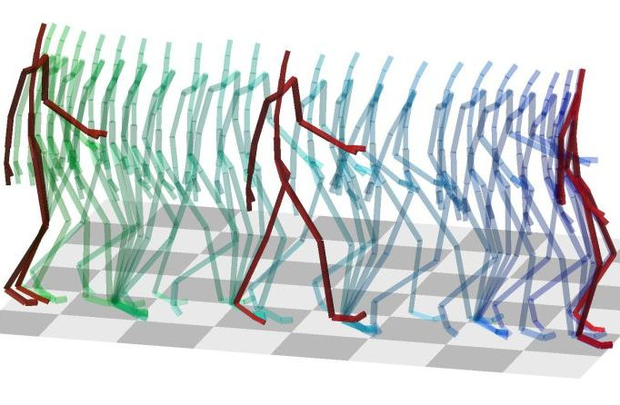
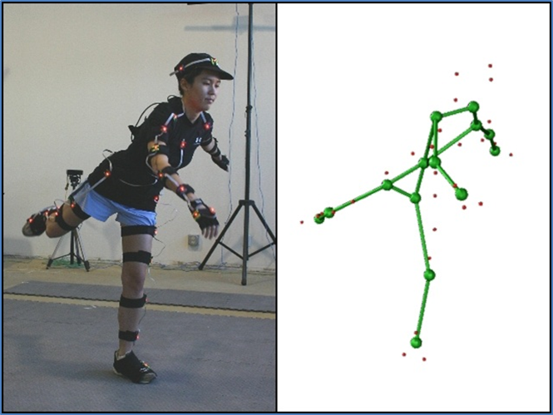
How is Similarity Measured?
Sports – high data acquisition
VR – real time data acquisition -> simulation time
Modeling human body -> skeleton

Slide 5
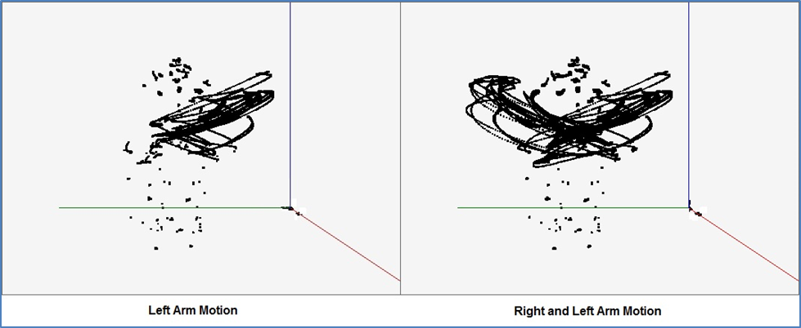
Human Motion can be modeled as Sets of 3D Curves
3D Curves generated by MUMS tool from a shoulder exercise.
These two diagrams capture the accumulated tracks of two snapshots.
It shows all sensors data including those from head, torso, abdomen, arms and legs.

Slide 6
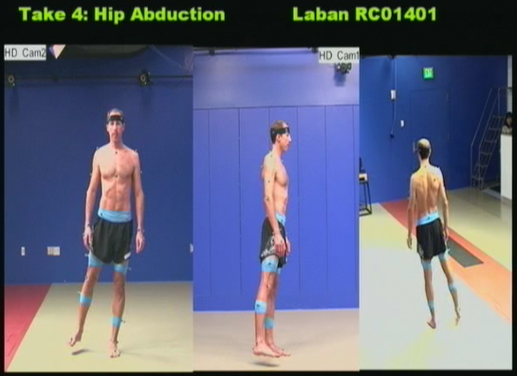
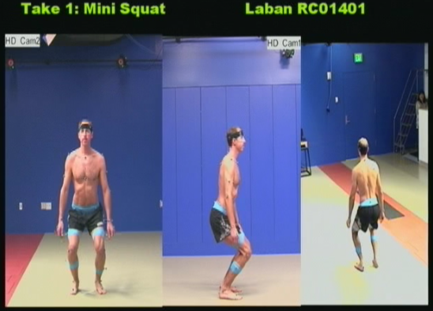
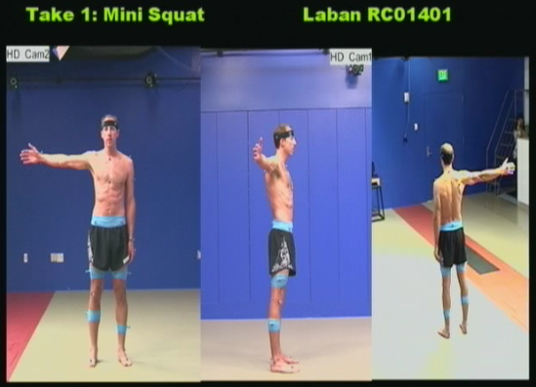
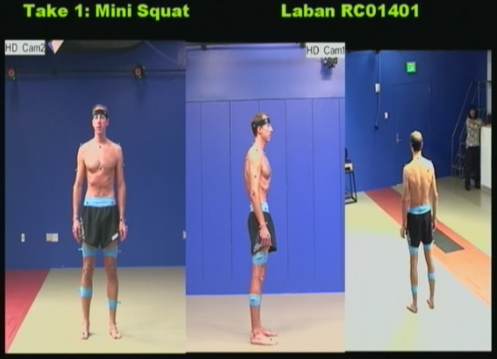
Utilize Time3D data from HMTR Project
Four Key Rehabilitation Exercises were chosen and analyzed in HMTR project by
Dr. Yunyu Wang – Certified Movement Analysis, LABANotation Reconstructor and Teacher
Dr. James Carollo – Physical Medicine and Rehabilitation, Ortophaedics, Bioengineering, School of Engineering and Applied Science.

Slide 7
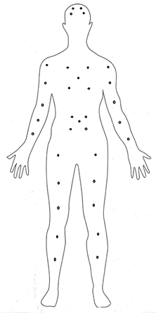
Sample File, Assumptions, Markers position
MoCap Data
# Pts = 34
# Video Frames = 1238
Video Frame # 1
1 733.4042 1447.329 1659.807
2 720.8265 1322.164 1659.62
…
33 452.7758 1343.254 38.04591
34 666.9445 1325.737 36.31926
Video Frame # 2
…
3D data per marker
Sampling rate
Body position for markers

Slide 8
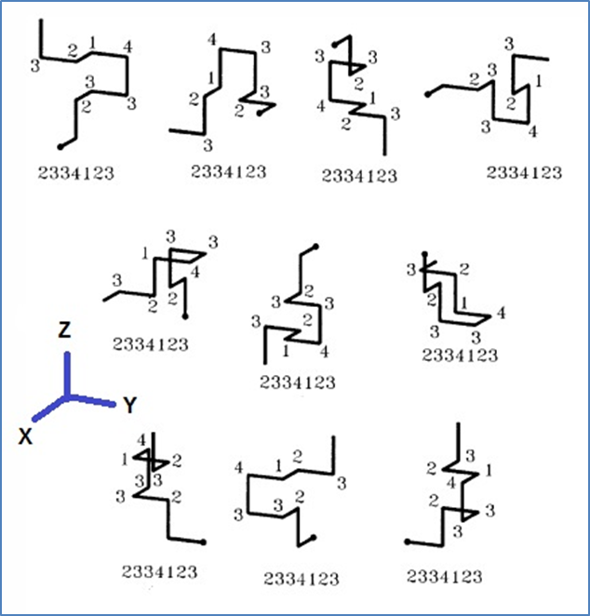
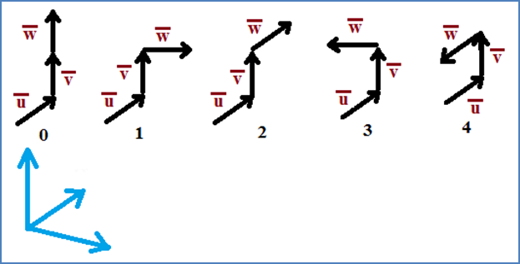
Chain Code - Orthogonal Changes of Direction
Invariant under Translation
or Rotation [Bribiesca, 2006]

Slide 9
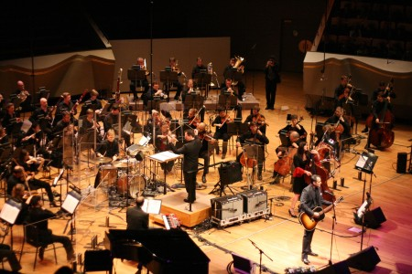
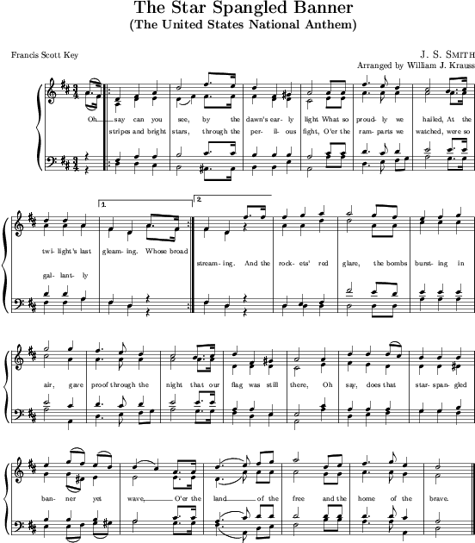
Adding Time into the Equation
The United States National Anthem
MP3, CD
What is equivalent representation in human motion movement?

Slide 10
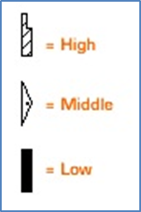
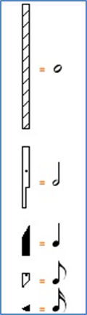
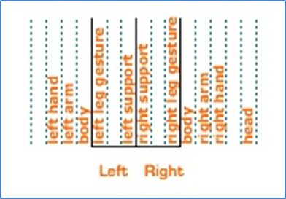
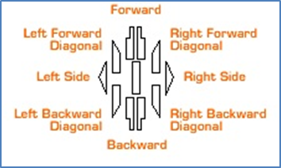
LABANotation
LABANotation: a record of how one moves so it can be repeated. This notation includes a set of symbols that are placed on a vertical staff, where its vertical dimension represents the symmetry of the body, and its horizontal one represents the time
[Bouchard, 2008]

Slide 11
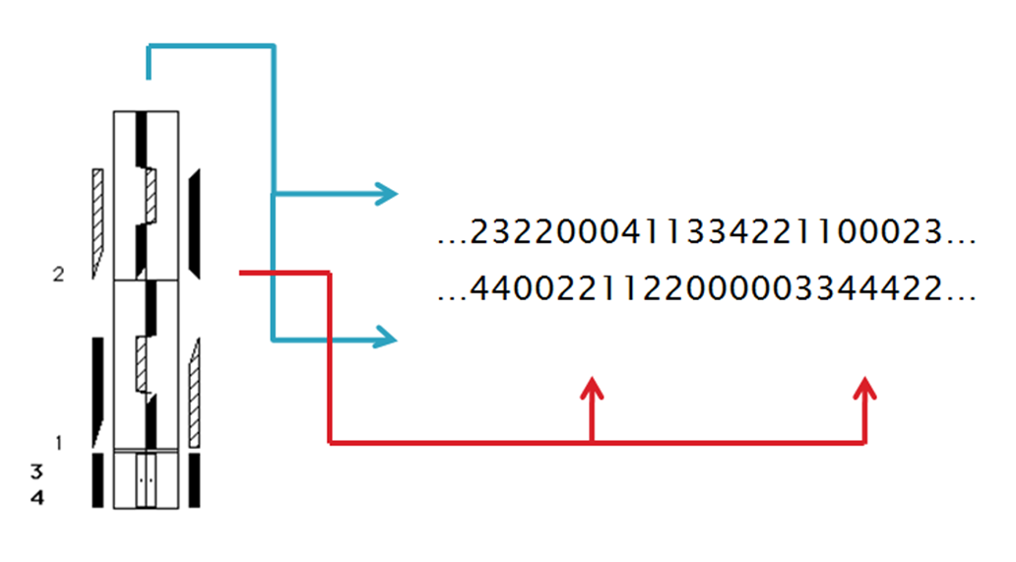
Spatial and Temporal Analysis
Movement on the right leg track can be encoded in chain code for further analysis.
Note that there are five sensors per leg.
Therefore five corresponding chain code may be generated.
Measures of 3 beats display from bottom up.
Different movements of body limbs are encoded with directions

Slide 12
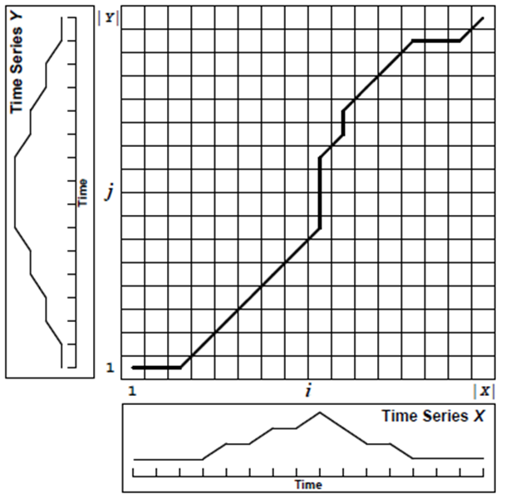
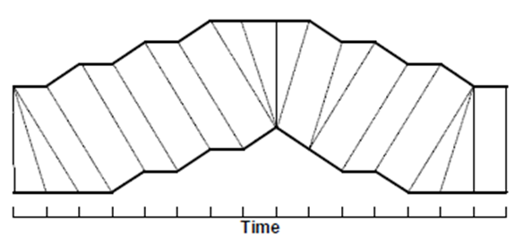
Dynamic Time Warping
Finds the optimal alignment between two time series
Use the value calculated based on the optimal alignment to represent the similarity.
If two time series are the same, the similarity value is zero.
Y₂
X₄
Y₂
X₂
Similarity values contributed by paris of subsequence pair
X₂
X₄
d(Y2, X4)+d(Y3,X5)+d(Y4,X6)+d(Y5,X7)+d(Y6,X8)=0
> d(Y2, X2)+d(Y3,X3)+d(Y4,X4)+d(Y5,X5)+d(Y6,X5)=1+1+0+1+0+1=4
Notes:
The top time series curve Y can be considered as a reference curve (master dancer movement).
The buttom time series curve X can be considered as a curve to compare with the reference curve (a student dancer movement).
It delays the start until 3 time slots, the next 5 timeslots, it follows the reference curve. Then it skips 3 timeslots, It follows one, skip one, and so on.
If the two curves are the same, the right diagram should be a diagonal line. The area between the

Slide 13
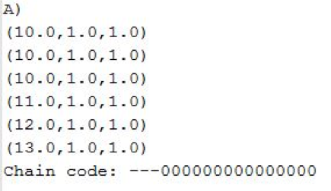
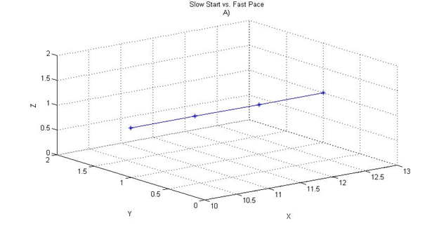
Slow Start vs. Fast Pace – 3D ChainCode

Slide 14
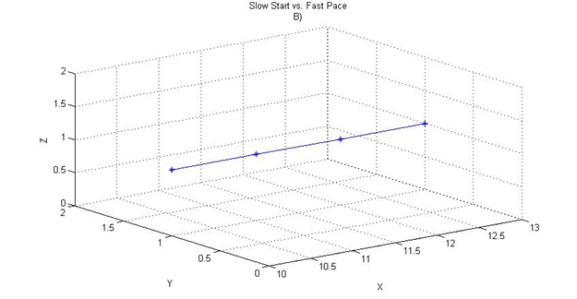
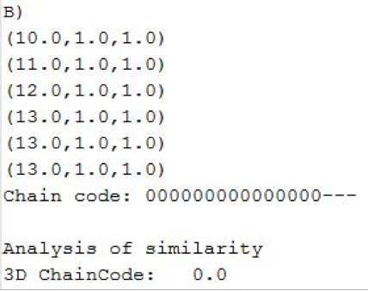
Slow Start vs. Fast Pace – 3D ChainCode

Slide 15
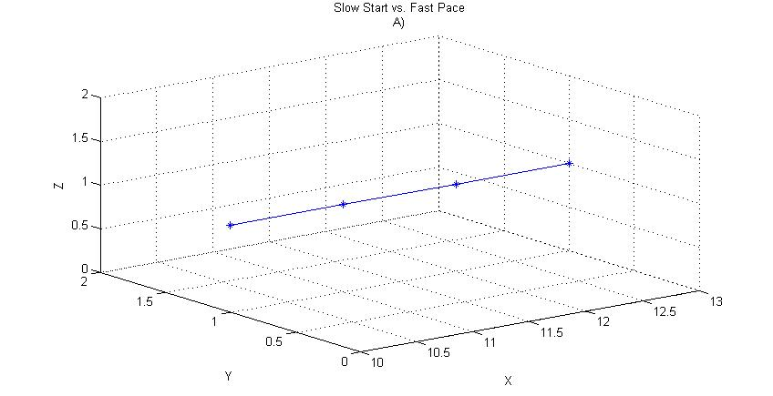
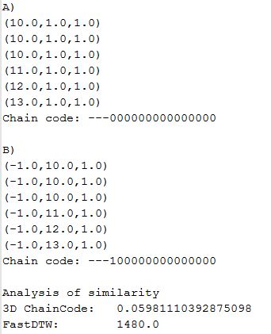
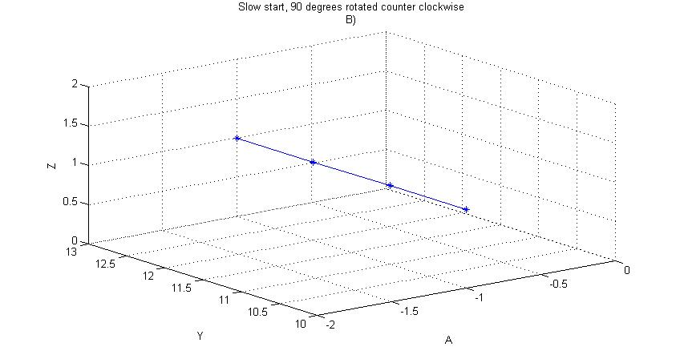
Slow Start rotated 90º – 3D ChainCode

Slide 16
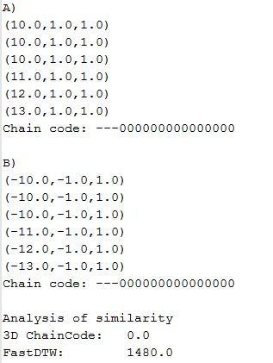
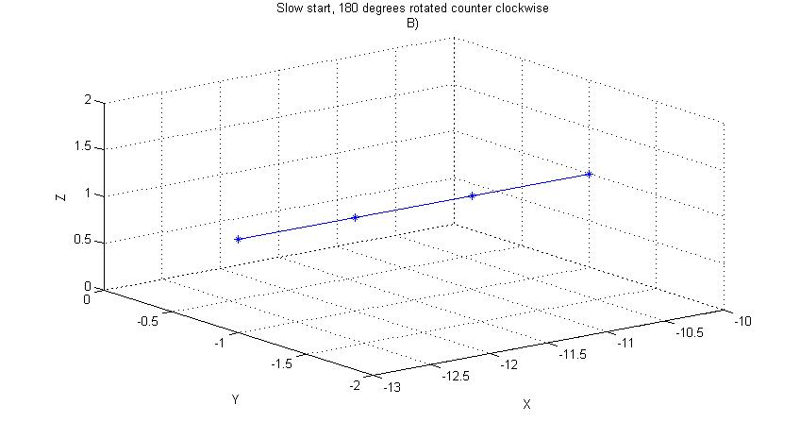
Slow Start rotated 180º – 3D ChainCode

Slide 17
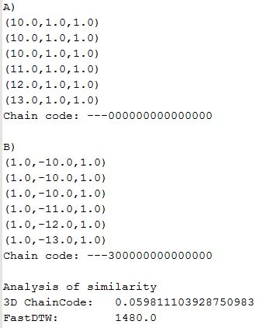
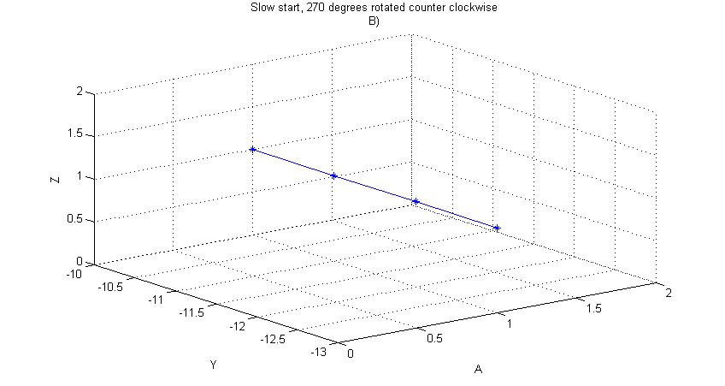
Slow Start rotated 270º – 3D ChainCode

Slide 18
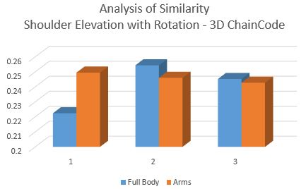
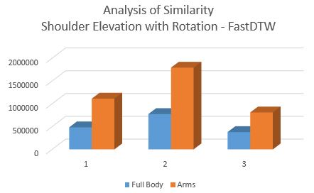
Notes:
Combine the two charts in one and use different colors (green or purple) for fastDTW.
Make it as big as possible.

Slide 19
Standing Hip Abduction Exercise

Slide 20
Mini Squat Exercise

Slide 21
Posterior Pelvic Tilt Exercise

Slide 22
Contribution 2: Enhanced LABANotation for Rehabilitation
LABANotation is designed for specifying dances.
We studied its usage and suggested the enhancement for specifying the rehab exercises.
Focus on the
Express movement precision by adding new symbols
Minimize notation modifications and changes
Apply the new notation on improving the specification of key rehab exercises in the HMTR project.

Slide 23
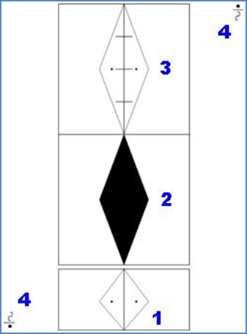
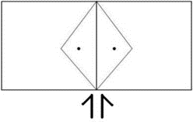
Enhanced LABANotation for Rehabilitation – Mini Squats Exercise
Start standing with equal weight distributed between right and left legs
Place feet shoulder width apart
Keep torso upright, avoid bending at the waist
Slowly loser yourself by bending ankles, knees, and hips
Return to standing
Notes:
Add some if not all symbols of the body on the right side.

Slide 24
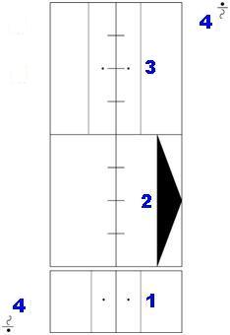
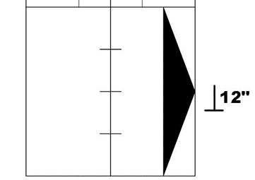
Enhanced LABANotation for Rehabilitation – Standing Hip Abduction Exercise
Start standing with equal weight distributed between right and left legs
Slowly, shift your weight to the left side
Raise the leg out to the side ~ 12’’
Keep the right foot facing forward
Keep the torso upright
and avoid leaning
to the side
Notes:
Should talk about Labanotation only specifies six degree to measures (extra fast, ….slow, extra slow). In Physical Therapy, they should be more precise.

Slide 25
Contribution 3: HMTR System Design and Tool Evaluation
We propose a Human Motion Tracking and Reasoning (HMTR) Software Architecture.
Evaluates Tools for HMTR System Design
LabanWriter (Mac version from Ohio State)
LabanDancer (Windows version from Dance Bureau)

Slide 26
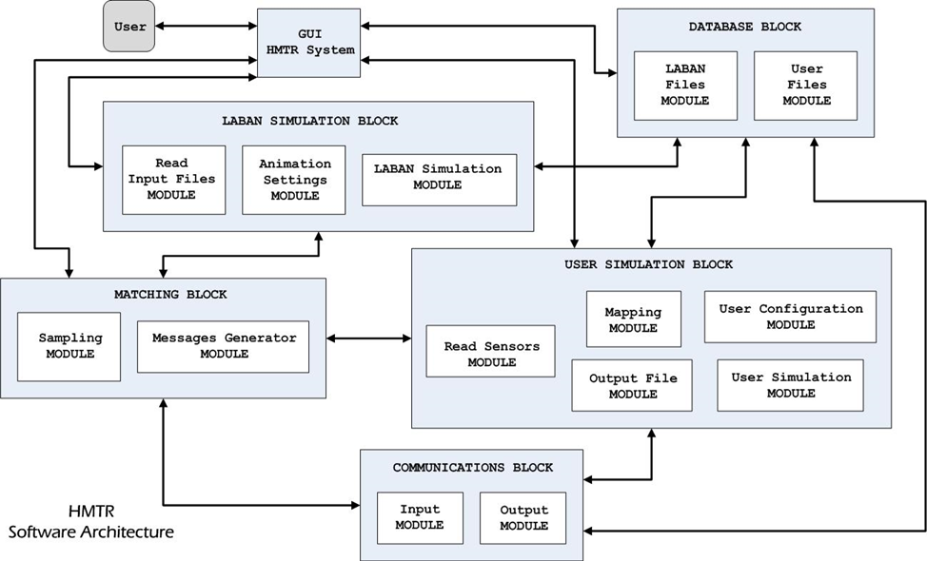
Proposed Human Motion Tracking and Reasoning (HMTR) Software Architecture

Slide 27
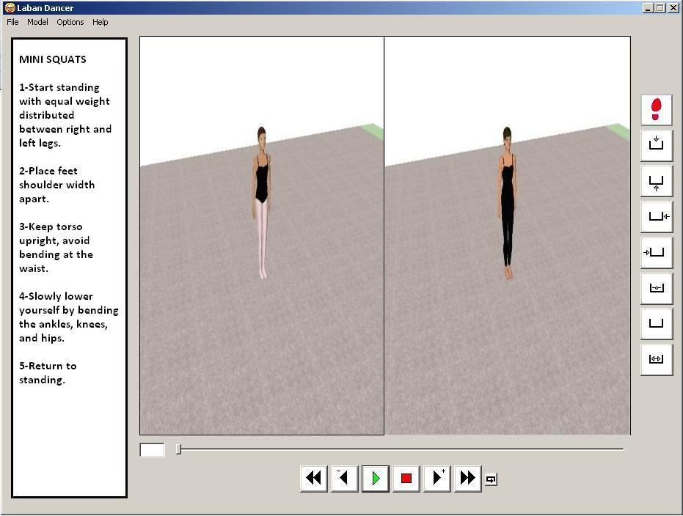
Suggested Enhancement of LabanDancer Software

Slide 28
Lessons Learned
C3D data is a binary data difficult to parse.
Use tool from Internet to extract into text form and feed them in chain code program.
The original implementation 3D ChainCode dissimilarity algorithm is very slow when applying to real exercise data. The steps are re-examined and improved for the time performance.
Bribiesca’s group did not consider the idle situation and did not encode the elapsed of time. They are interested in shape of the curves, while we are interested in movement.
Laban Dancer executable code works fine but the source code was compiled in different version of visual studio and even the original authors can not provide a working project.

Slide 29
Contributions
Propose A new model to represent human motion
Use LABANotation to analyze human motion on spatial and temporal domains
Enhancement of LABANotation for rehabilitation
Develop a software tool to perform the analysis of human motion similarity on motion capture sessions
Propose a HMTR software architecture
Propose enhancements for LabanDancer software for rehabilitation purposes

Slide 30
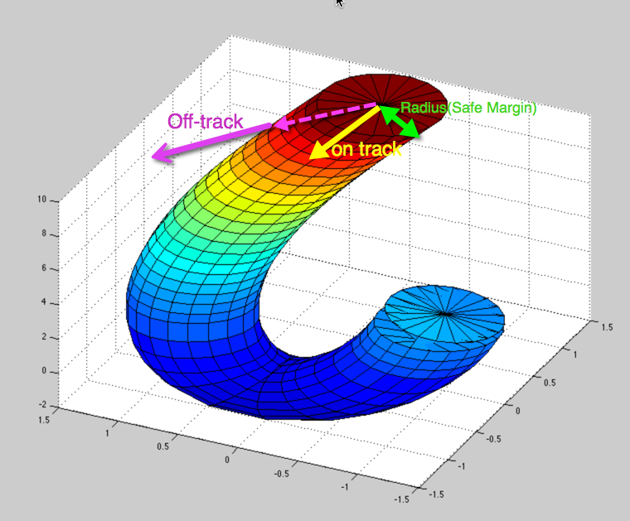
Future Research
Use this framework in another areas, i.e. dancing, video games
Improve run time for the analysis of human motion, i.e. using nVidia CUDA tools
Getting additional data with semantics for further analysis of similarity
Define additional properties such off-track, sustain and develop procedure for computing the values for the properties.
Notes:
Off-track can be defined by distance > radius in the above diagram, it can also be defined by the angle between subsection of the curve and the reference curve.
Or it can have both criteria. If you have time, you discuss slow movement and fast movement.
Sustain includes calculate of speed from subsection of the curve. When variation of speed is small (same speed) and the value of speed is small (depending on the age of course).

Slide 31
Conclusion
Propose A new model to represent human motion
Use LABANotation to analyze human motion on spatial and temporal domains
Enhancement of LABANotation for rehabilitation
Develop a software tool to perform the analysis of human motion similarity on motion capture sessions
Propose a HMTR software architecture
Propose enhancements for LabanDancer software for rehabilitation purposes
The Analysis of human motion is needed in different areas of study.
The proposed framework provides feedback regarding motion similarity of two given motion capture sessions
The Analysis of human motion similarity can be done on spatial, temporal, or both domains.
Three papers were published. Will submit the work on the comparison of chain code and fastDTW.

Slide 32


Slide 33


